Slide 1



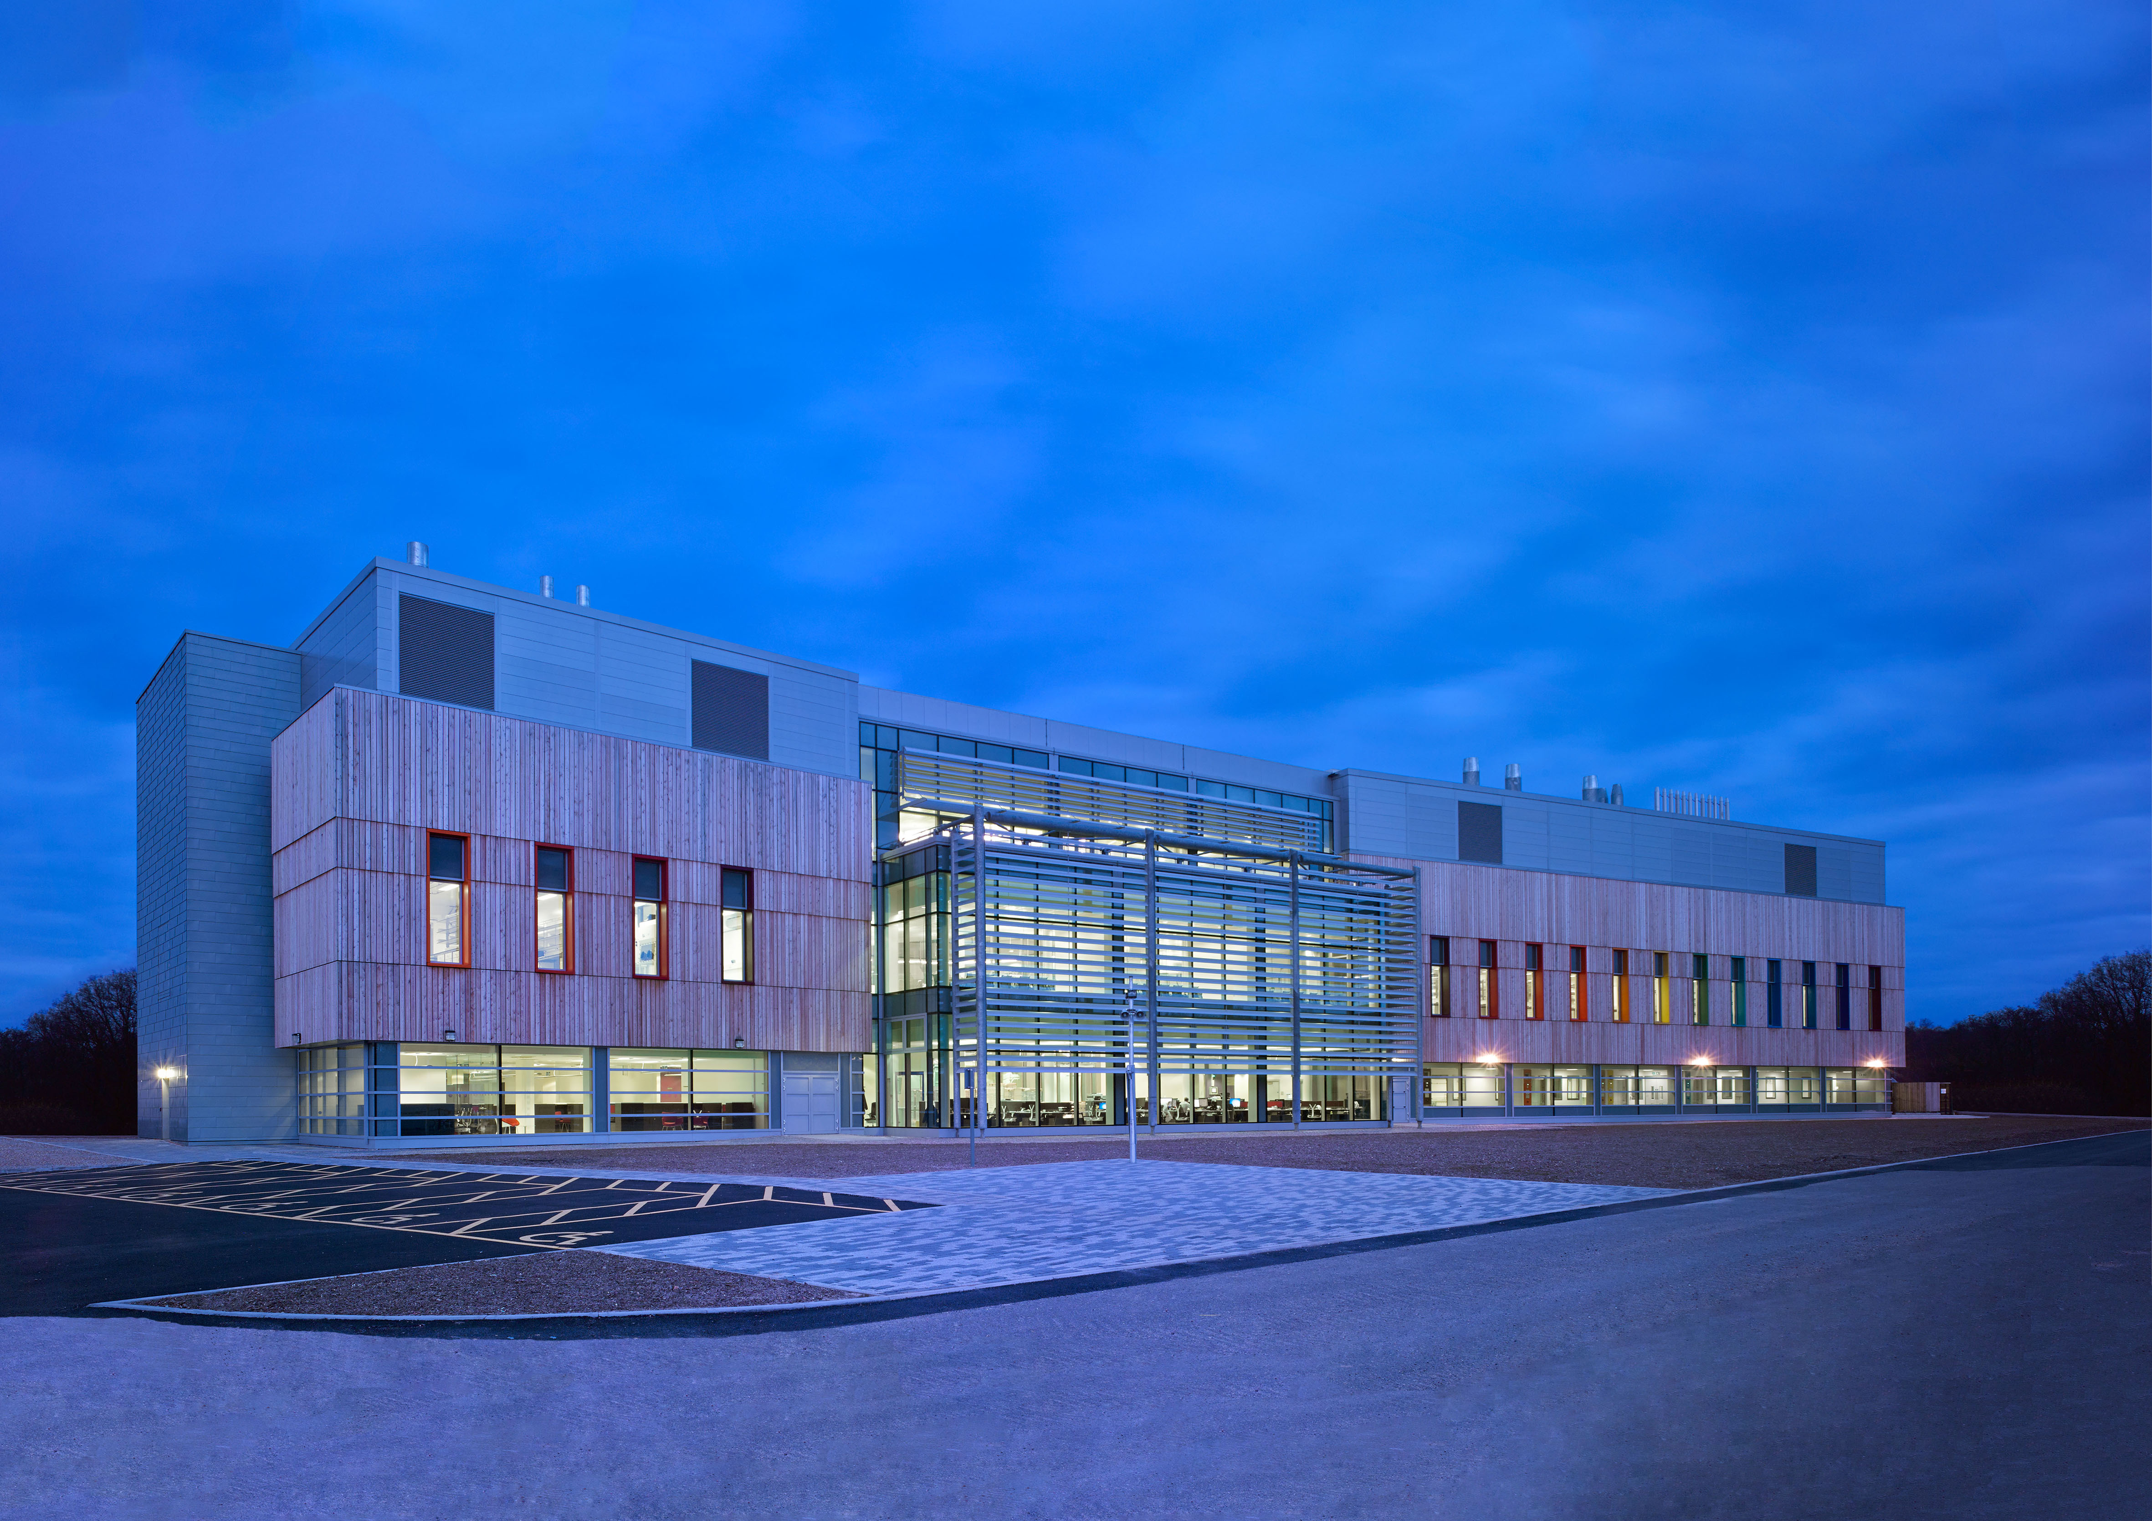
Southern England Virology Network
Wednesday 19th September 2018
Preventing and controlling
viral diseases
Ash CCL - for more information please contact barry.atkinson@pirbright.ac.uk or anthony.wilson@pirbright.ac.uk
12:00 Buffet lunch (external visitors) and networking
13:00 Feeding behaviour of Culicoides biting midges in zoos in the UK – implications for disease transmission and control
Marion England
13:30 Functional resistance to neuraminidase inhibitors in avian influenza viruses Dagmara Bialy
14:00 Courses, collections and collaborations
  The National Collection of Pathogenic Viruses (NCPV)
  The European Collection of Animal Cell Cultures (ECACC)
  Gnatwork - building capacity for research on neglected vectors
  Novel and Dangerous Pathogen Training
  The Biomedical Research facility at the University of Surrey
  Infravec2 – no cost vector research products
14:30 Coffee
15:00 Evaluation of the immunogenicity of Nipah virus vaccine candidates in pigs
Becca McLean
15:30 WRLFMD: 60 years of global foot-and-mouth disease surveillance Kasia Bankowska
16:00 Close

